Slide 1
CE461-FINAL PRESENTATİON TERM PROJECT
Bearing Capacity of Sands

Slide 2
OUTLINE
Introduction
Theory
Cases
First Main Case
Second Main Case
Conclusion

Slide 3
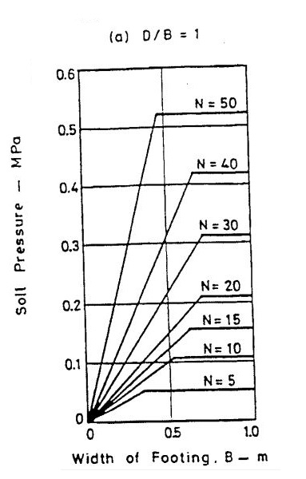
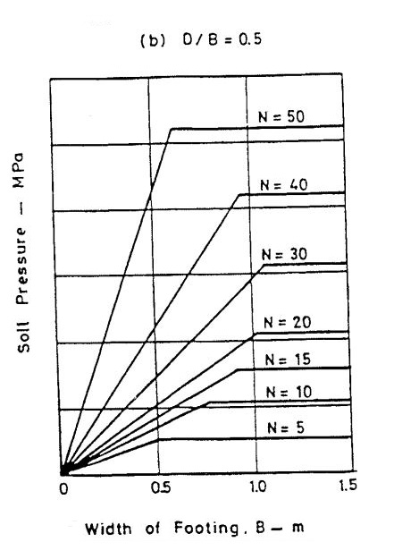
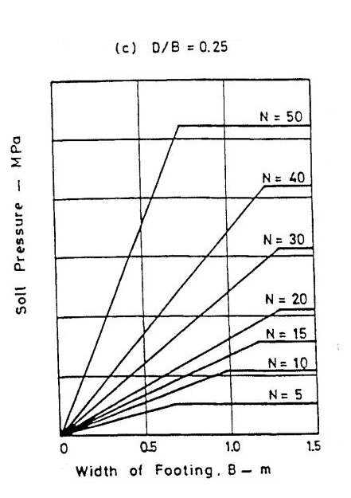
N values should be taken from the depth between 0.5B and2B.

Slide 4

N₆₀ =N* $\frac{ER}{0.6}$*C_{B}*C_{S}*C_{R} (N₁)₆₀ = N₆₀*C_{N}
where
ER = Hammer Energy Ratio
C_{B} = Correction Factor of Borehole Diameter
C_{S} = Correction Factor of Samplers Without Liners
C_{R} = Correction Factor of Rod Length
C_{N} = Overburdan Correction Factor

Slide 5
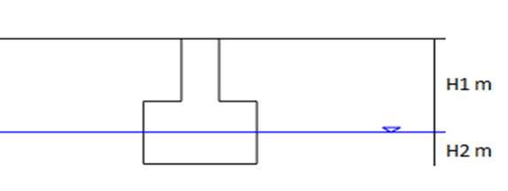
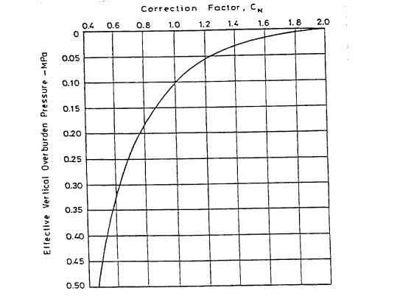

σ = Effective Stress = H1* γ_{dry}+H2*( γ_{dry}- γ_{water})
C_{N=}$\frac{9.78}{\sqrt{σ}}$

Slide 6
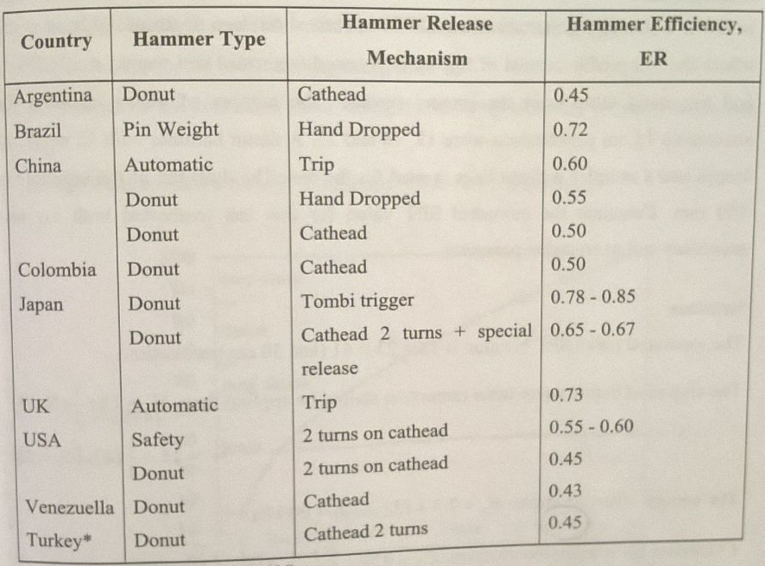
Hammer Energy Correction Factors

Slide 7
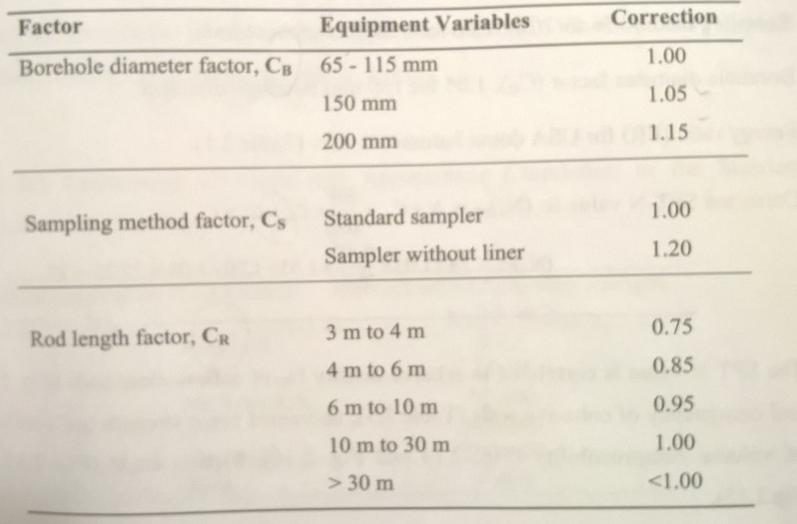
Cb, Cs, Cr Coefficients

Slide 8
Second Main Case
N values should be taken from the depth between 0.5B and2B.

Slide 9
(q_{n})_{all} = 11*N₆₀*C_{w} (kN/m²) for 25 mm settlement (footings)
(q_{n})_{all} = 22*N₆₀*C_{w} (kN/m²) for 50 mm settlement (rafts)

Slide 10
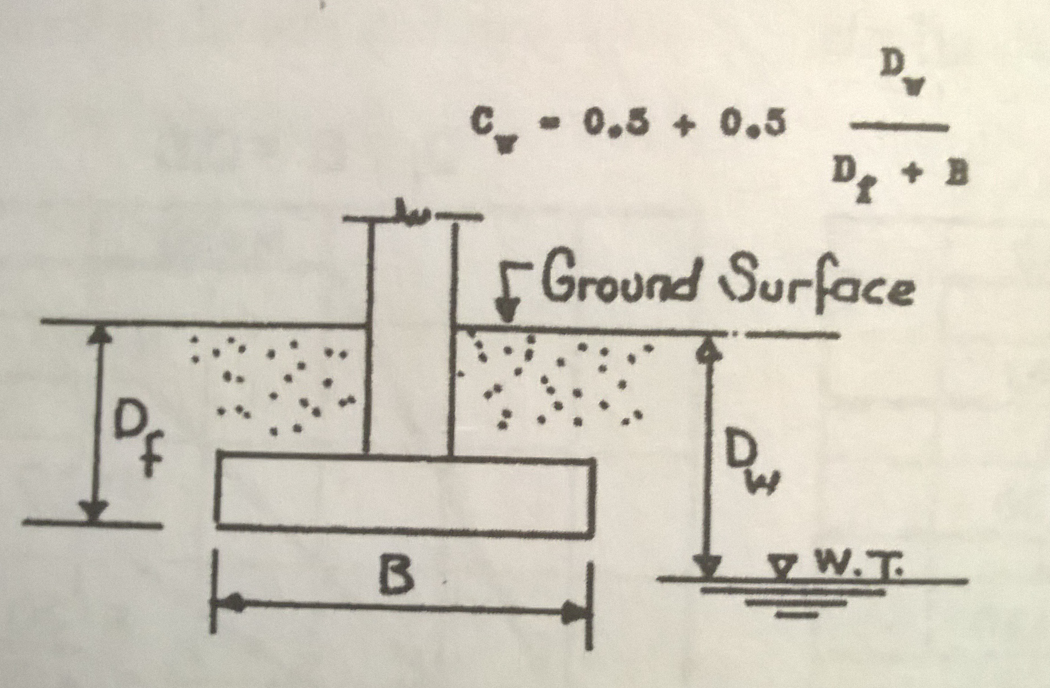
Groundwater Correction Factor, Cw

Slide 11
In Summary
Two Main Cases was Analayzed
The Main Purpose
To help 3. Class students to understand Bearing Capacity of Sands

Slide 12
References
Peck, R.B., Hanson, W.E. and Thornburn, T.H. (1974) Foundation Engineering, John Wiley and Sons, New York
Dr Birand,A., Dr.Ergun, U., Dr. Erol,O, 2011, CE366 Foundation Engineering 1 Lecture Notes, February 2011, Ankara

